Slide 1
Churn prediction using Bagging
N. Thanuja Sri

Slide 2
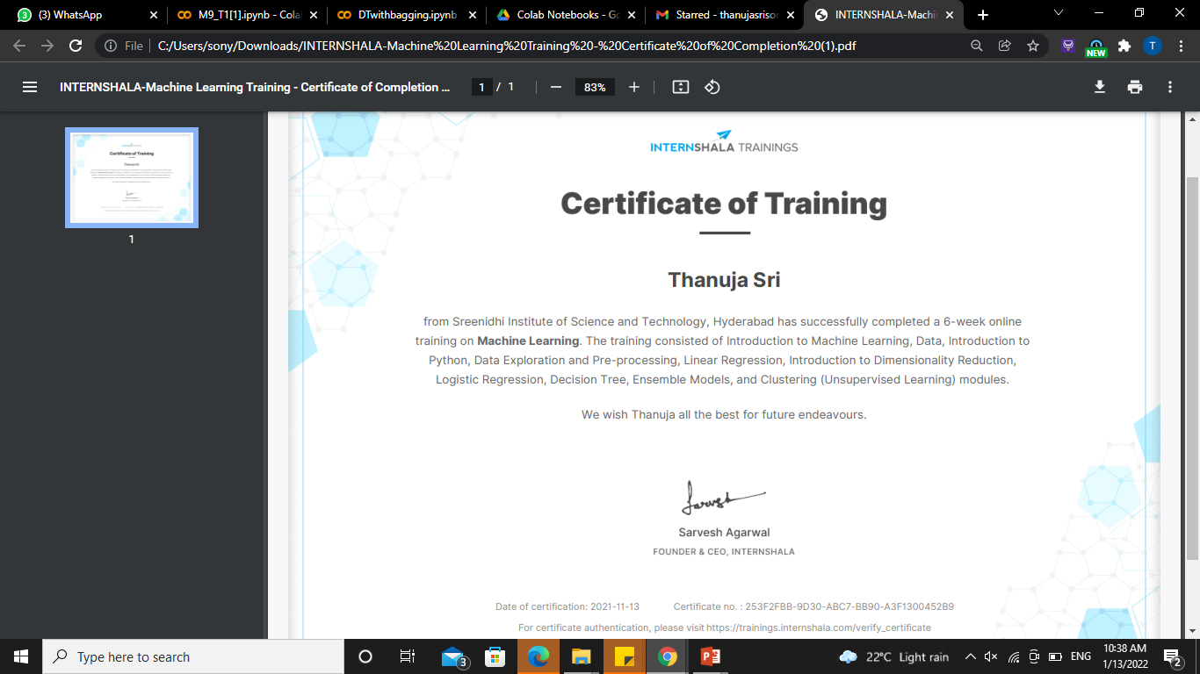
Platform: Internshala Trainings

Slide 3
Introduction
Churn is defined in business terms as ‘when a client cancels a subscription to a service they have been using.’
Churn Prediction is essentially predicting which clients are most likely to cancel a subscription i.e ‘leave a company’ based on their usage of the service.
From a company point of view, it is necessary to gain this information because acquiring new customers is often arduous and costlier than retaining old ones. Hence, the insights gained from Churn Prediction helps them to focus more on the customers that are at a high risk of leaving.
A common example is people cancelling Spotify/Netflix subscriptions.

Slide 4
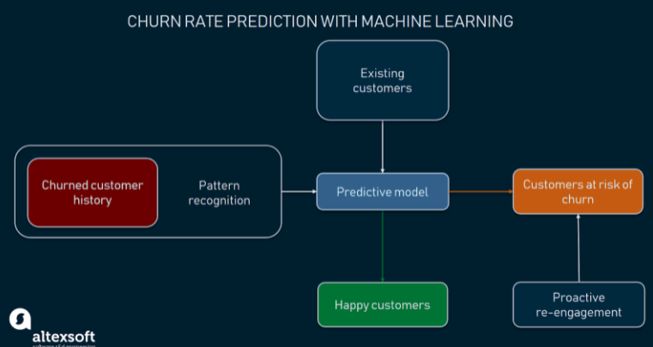
Machine Learning use
As to identifying potential churners, machine learning algorithms can do a great job here. They reveal some shared behavior patterns of those customers who have already left the company. Then, ML algorithms check the behavior of current customers against such patterns and signal if they discover potential churners.

Slide 5
Bagging using Decision Trees
Decision tree as the name suggests it is a flow like a tree structure that works on the principle of conditions. It is efficient and has strong algorithms used for predictive analysis. It has mainly attributes that include internal nodes, branches and a terminal node.
Regression trees are grown deep.
Hence each individual tree has high variance, but low bias. Thus, averaging these B trees reduces the variance.
Bagging has been demonstrated to give impressive improvements in accuracy by combining together hundreds or even thousands of trees into a single procedure.
It is a general-purpose procedure for reducing the variance of a statistical learning method.

Slide 6
Implement bagging technique:
Determine the (n_trees) number of trees
Make (n_trees) number of bootstrap samples
For each bootstrap samples build a decision tree model and generate predictions
For every observation in test set, calculate the model of predictions made by n_trees

Slide 7
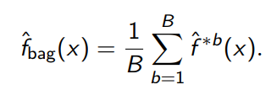
We can take repeated samples from the (single) training data set.
We will generate B different bootstrapped training data sets. We then train our method on the bth bootstrapped training set in order to get fˆ∗b (x).
Finally, we average all the predictions, to obtain below. This called as Bagging.
PROCEDURE

Slide 8
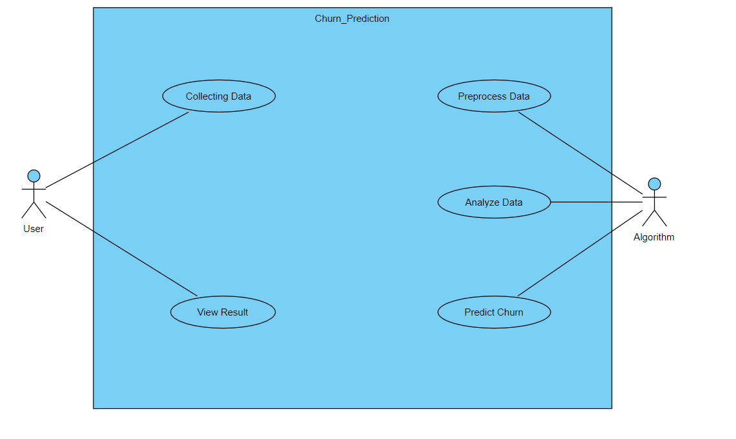
Use Case Diagram

Slide 9
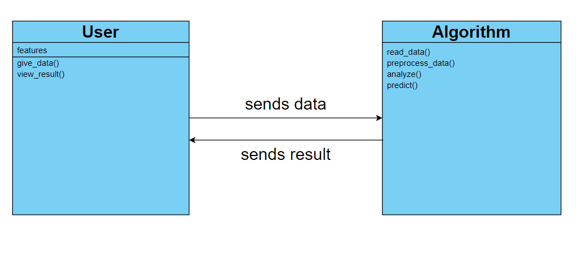
Class Diagram

Slide 10
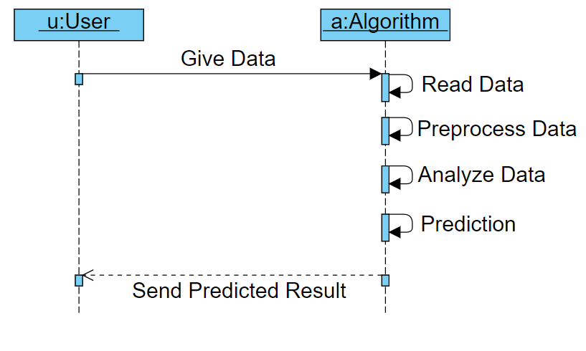
Sequence Diagram

Slide 11
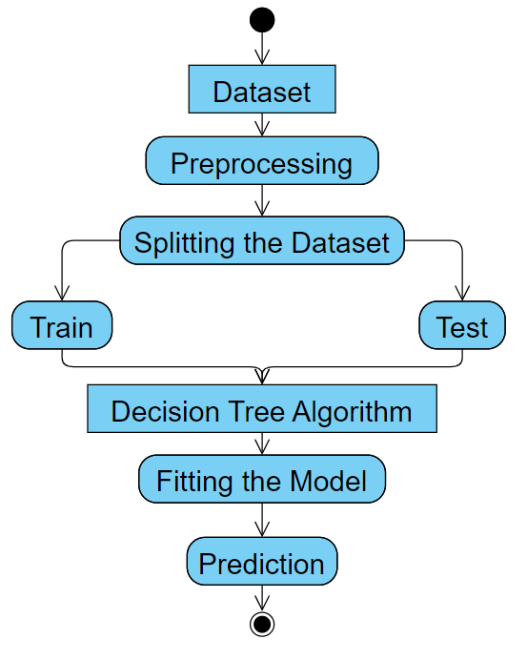
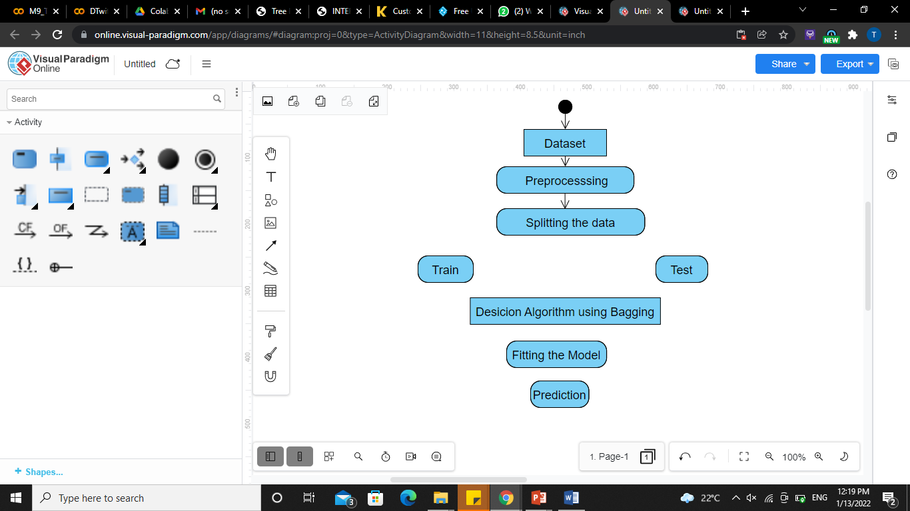
Activity Diagram

Slide 12
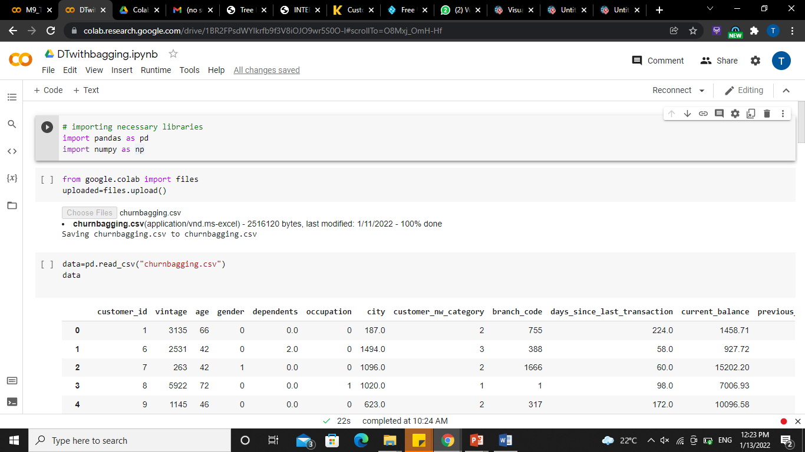
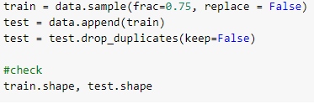
Implementation
1. Importing Libraries
2. Reading data
3. Splitting data

Slide 13

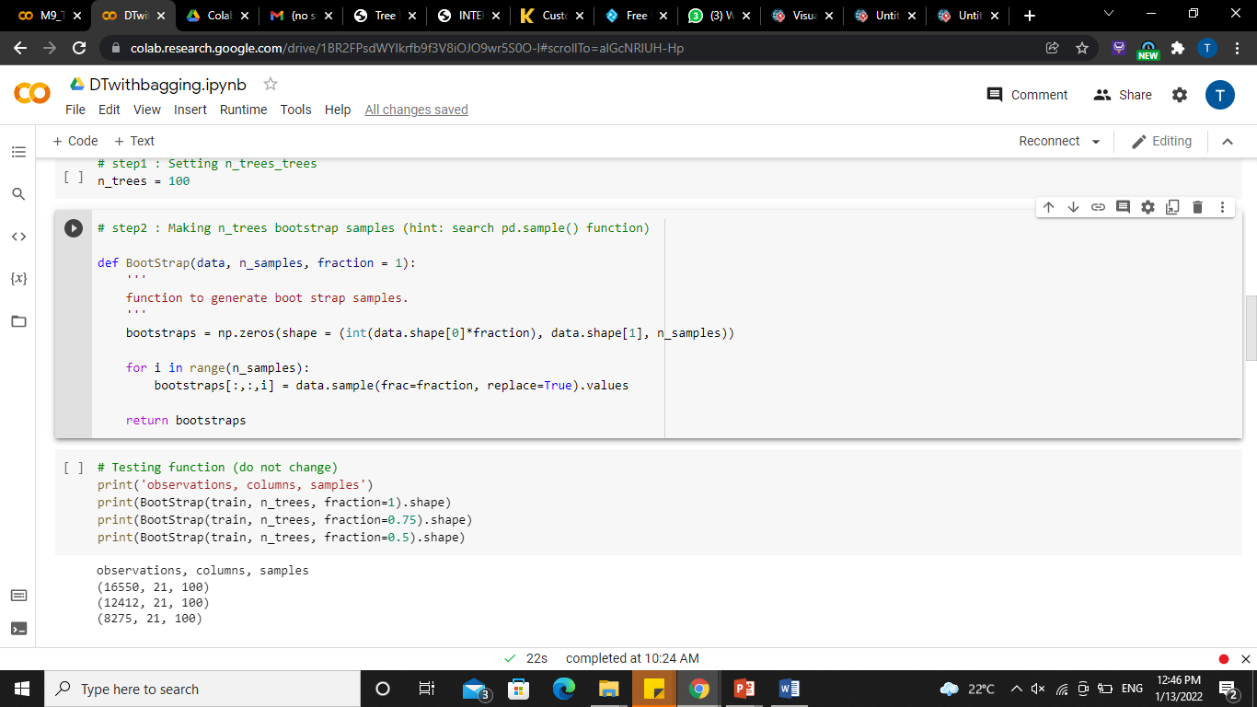
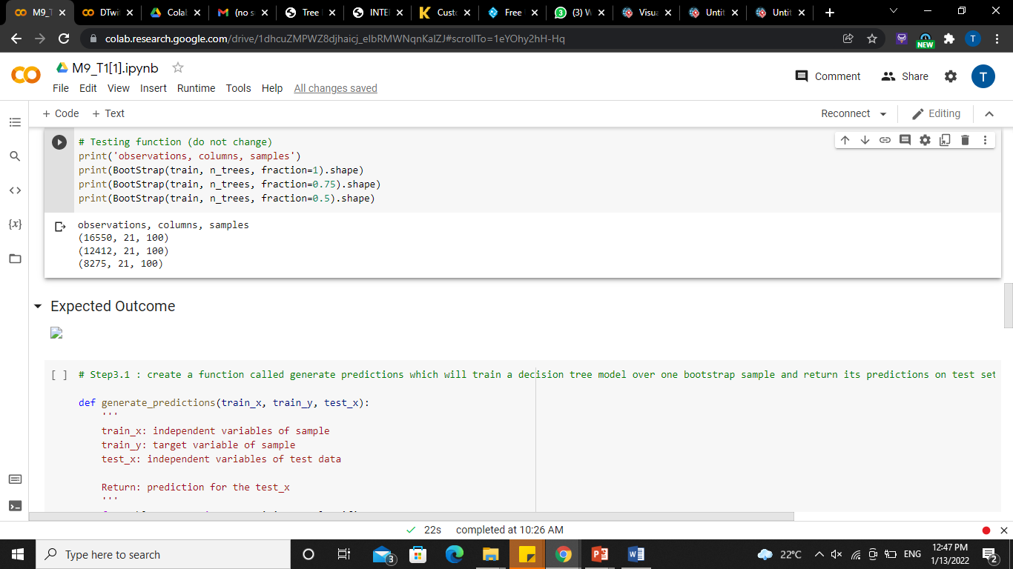
4. Steps to implement bagging technique with "n" number of trees
4.1. Setting n trees
4.2. Making n trees bootstrap samples
5. Testing Function

Slide 14
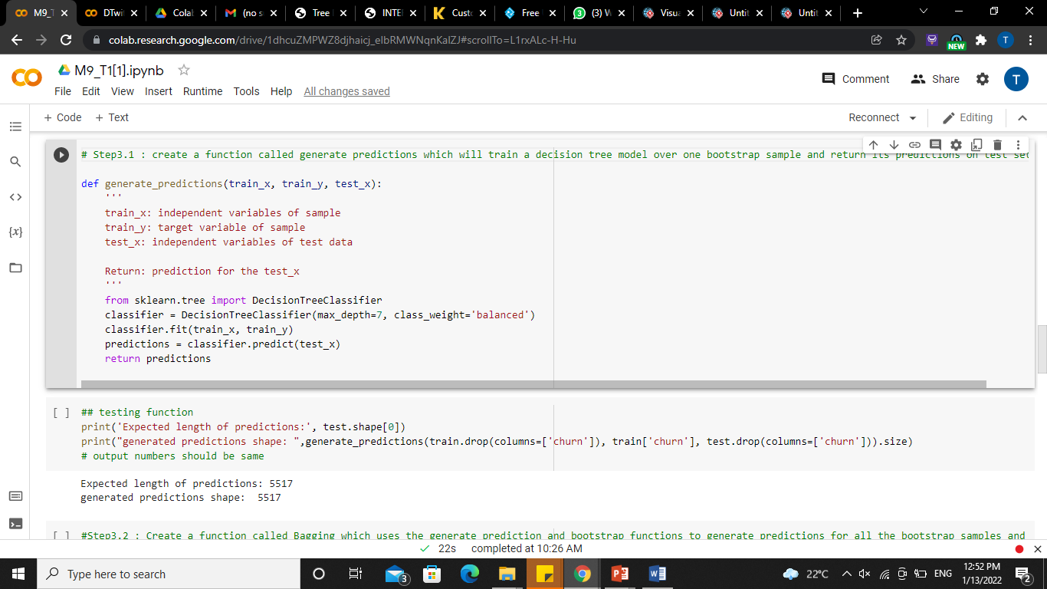
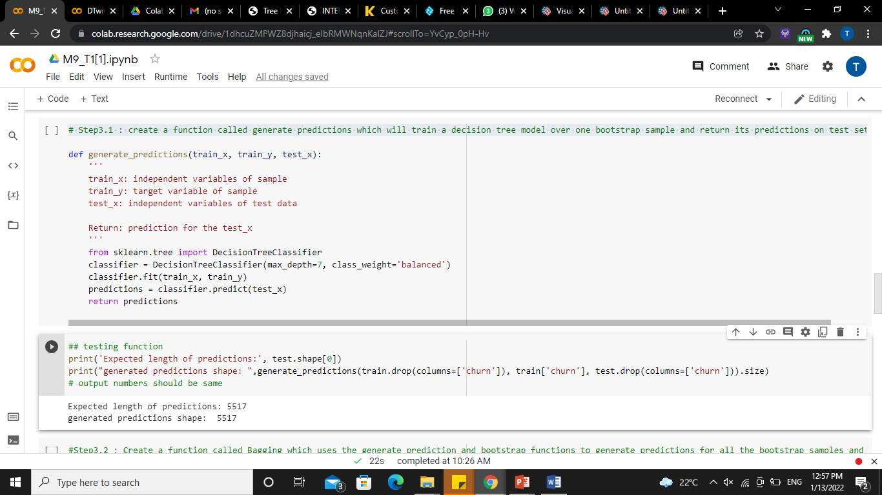
6.1 : create a function called generate predictions which will train a decision tree model over one bootstrap sample and return its predictions on test set.

Slide 15
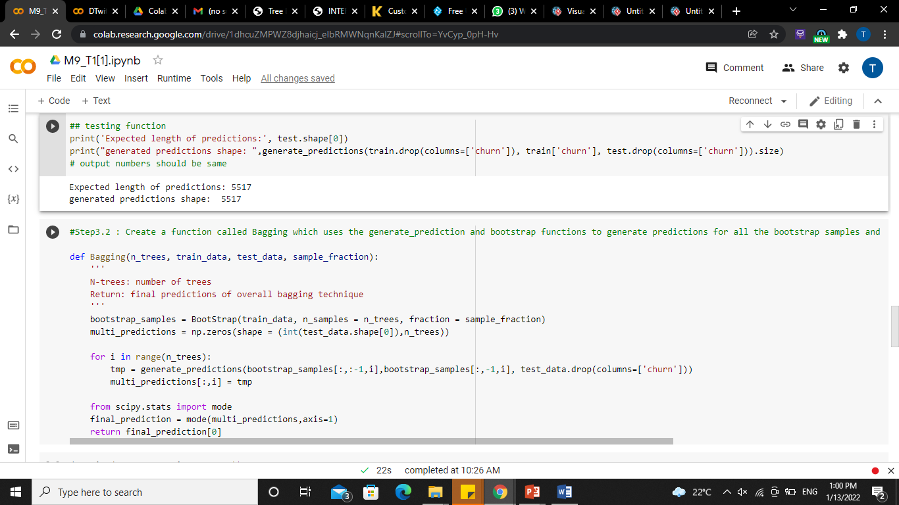
6.2 : Create a function called Bagging which uses the generate_prediction and bootstrap functions to generate predictions for all the bootstrap samples and calculate mode of predictions for each sample.

Slide 16
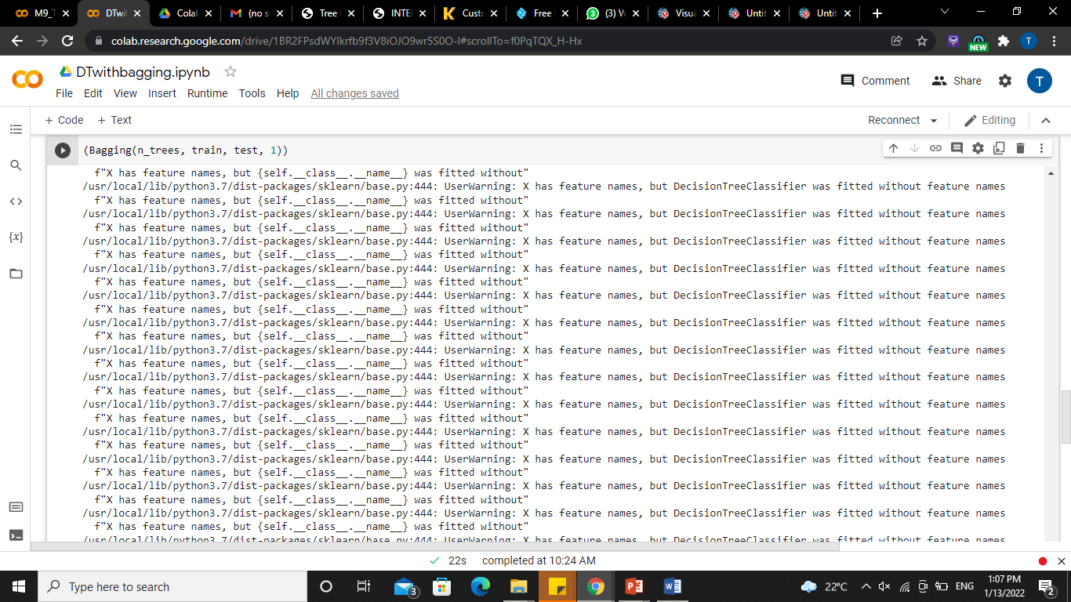
7. Bagging

Slide 17
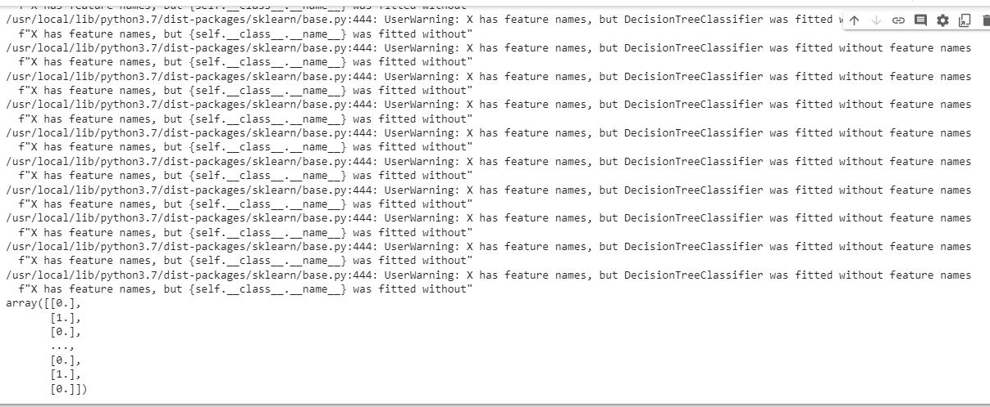

Slide 18
Conclusion
Churn rate is a health indicator for subscription-based companies. The ability to identify customers that aren’t happy with provided solutions allows businesses to learn about product or pricing plan weak points, operation issues, as well as customer preferences and expectations to proactively reduce reasons for churn.
It’s important to define data sources and observation period to have a full picture of the history of customer interaction. Selection of the most significant features for a model would influence its predictive performance: The more qualitative the dataset, the more precise forecasts are.
Companies with a large customer base and numerous offerings would benefit from customer segmentation. The number and choice of ML models may also depend on segmentation results. Data scientists also need to monitor deployed models, and revise and adapt features to maintain the desired level of prediction accuracy.

Slide 19
THANK YOU

